Slide 1

Proposal for a New Service Using AI: Accelerating Business with Data Analysis
Table of contents
Current State of the Consumer Finance Industry
Prediction Using Machine Learning Models
Our Business Proposal

Slide 2

Current State of the Consumer Finance Industry
It has become an era where customers demand the 4 S’s.
Speed
Review can be completed within a few minutes after application
Simplicity
Apply in just three simple steps on your smartphone.
Secret
Get a loan without your colleagues finding out
Safety
A trustworthy lending company
In order to improve profitability, the consumer finance industry
wants to provide services to more customers while managing risk.
wants to offer larger loans to customers with high creditworthiness.
Accurate risk management and identification of low-risk customers through customer data analysis are required
Utilize AI
From large volumes of information such as customer data, it is now possible to represent complex relationships that humans could not discover.

Slide 3
Table of contents
Current State of the Consumer Finance Industry
Prediction Using Machine Learning Models
Our Business Proposal

Slide 4
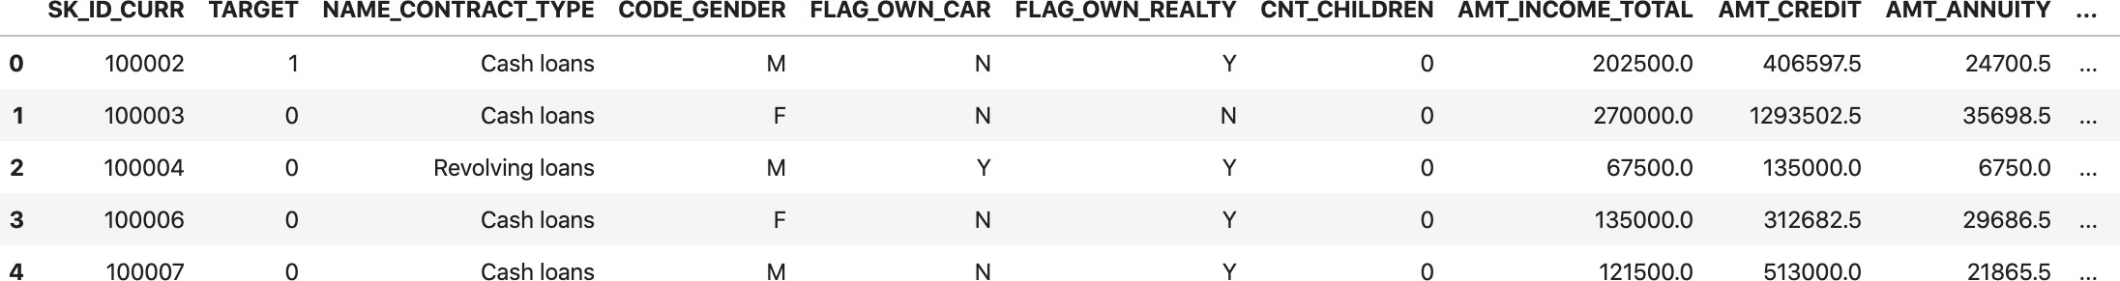
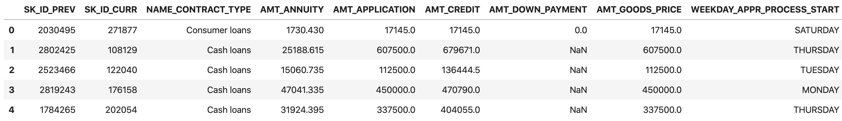
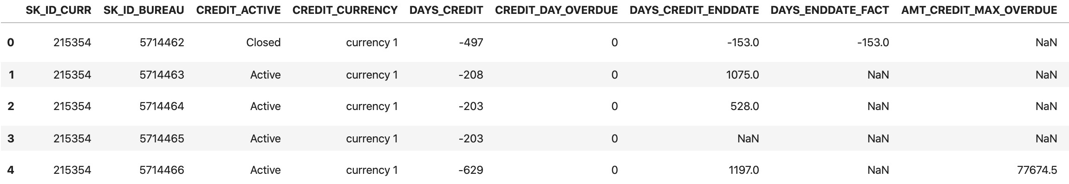
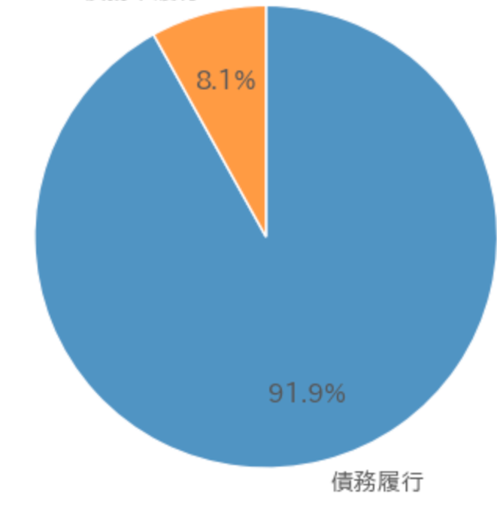
Introduction of Data Approximately 200 types of customer information have been accumulated as data.
A portion of the data you provided
Data Contents
Key data for each customer (gender, occupation, family information, presence/absence of default, etc.)
Information on customers’ past borrowings at other financial institutions (delinquent amounts, credit limits, etc.)
Monthly balance status of customers
Credit card usage information and withdrawal amounts for the month prior to the application date
Key data at the time of past applications (contract type, application amount, purpose of use)
POS cash balance information
Installment payment information
Proportion of Non-Defaulters
n= 307506

Slide 5
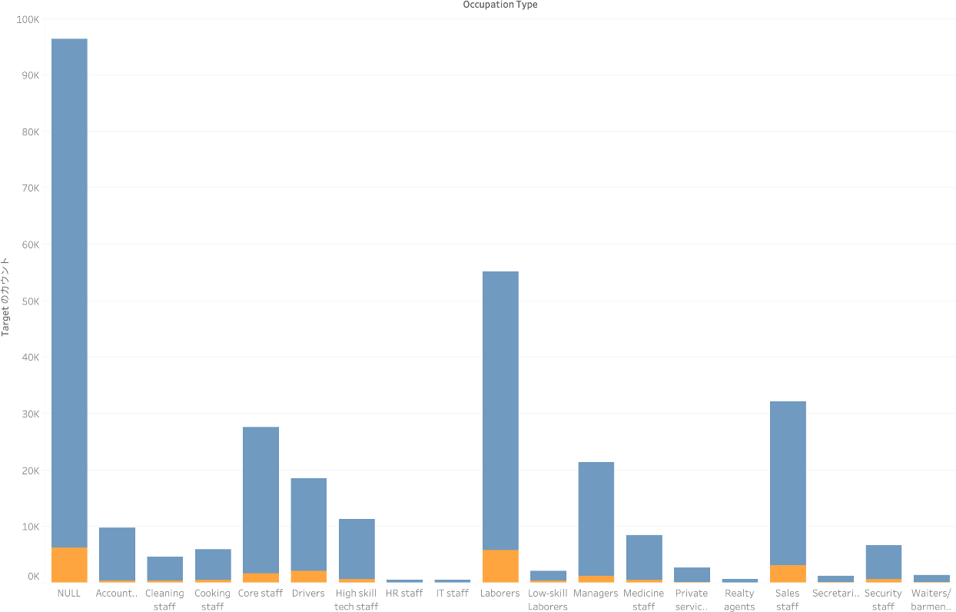
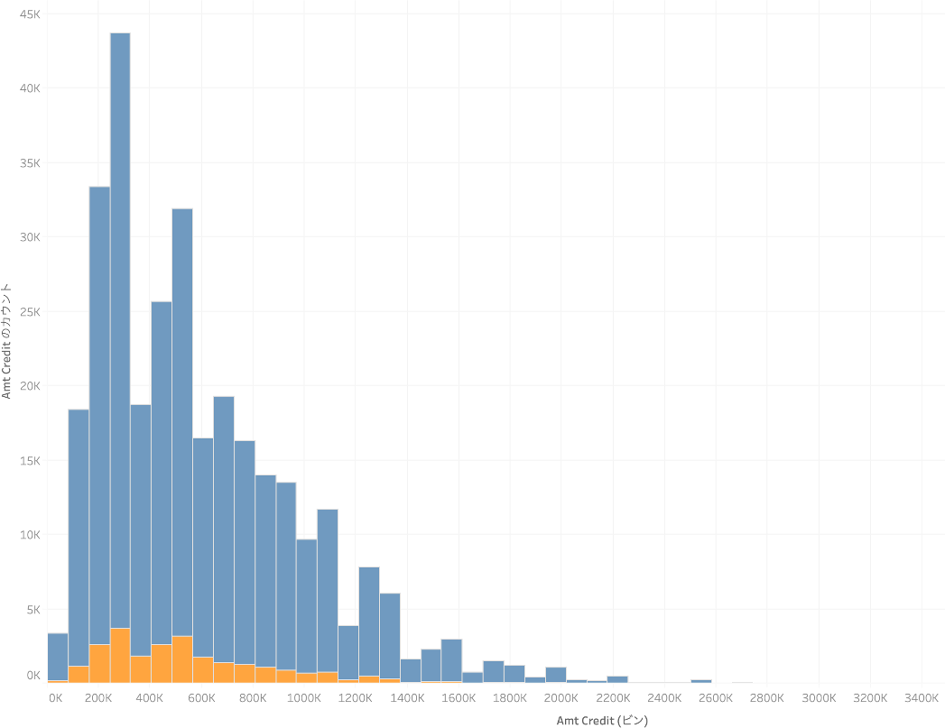
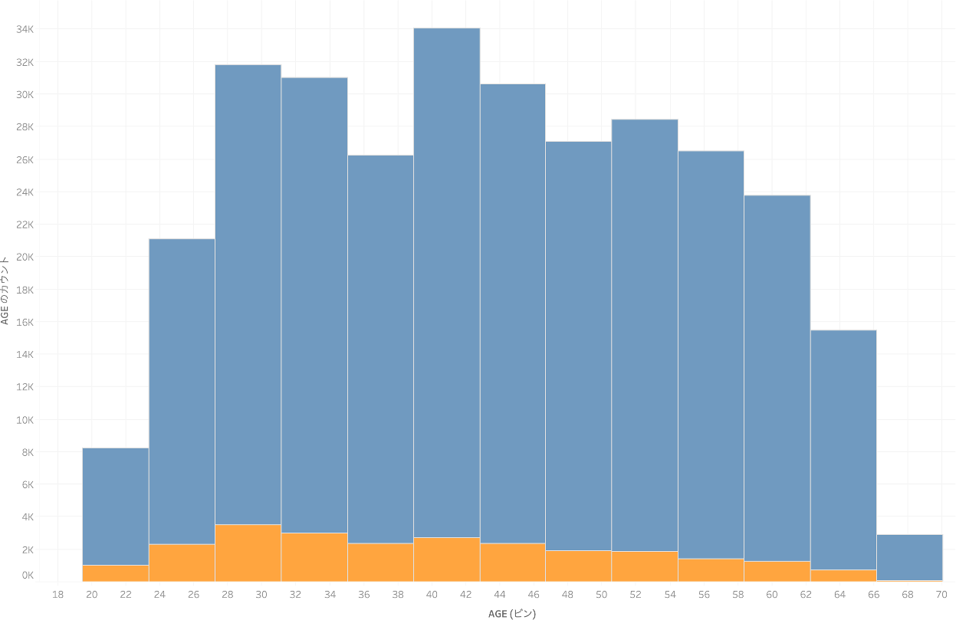
Data Visualization
We conducted various visualizations of the customer data.
Type of job
Non-Defaulters Defaulters
There are many NULL (unknown) entries; next most common is “Labor.”
No difference in credit balance is observed between non-defaulters and defaulters.
Credit balance
It is difficult to distinguish non-defaulters from defaulters using individual features alone.
Advanced analysis using machine learning methods is necessary.
Age
There is a wide range of customers from their 20s to their 60s.
5

Slide 6
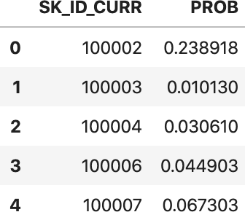
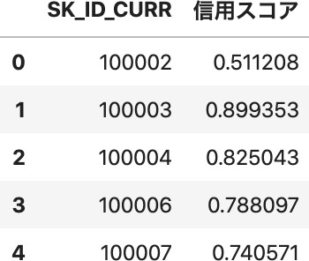
Overview of the Machine Learning Model
From customer information such as gender, occupation, family information, and credit card usage amounts, the proposed model predicts the probability of default.
Machine Learning Methods
Input
Output
Gender Occupation
Family info
…
Account info
…
Input data into machine learning methods
LightGBM XGBoost Neural Net
Output Prediction
Probability of Default
Defined as a credit score that is easy for humans to interpret*
Credit Score
Credit Score
= 1 -
Probability of default
*When calculating the credit score considering the distribution of default probability, a square root is taken.

Slide 7
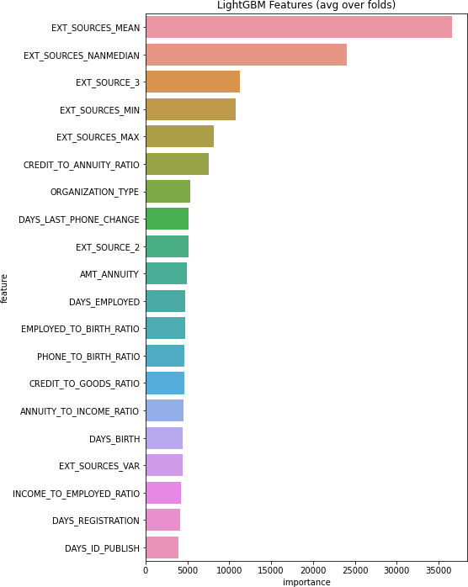
Important Features for Prediction
Many of the features important for prediction are those related to values from external sources.
Values from external sources
EXT_SOURCES_○○
Features
Importance
Features derived from processed data and statistical measures are important for AI predictions, indicating that the AI takes a different approach from human decision-making.
By utilizing both AI and human decision-making, highly accurate lending decisions become possible.

Slide 8
Table of contents
Current State of the Consumer Finance Industry
Prediction Using Machine Learning Models
Our Business Proposal

Slide 9



Our Business Proposals
Business proposals utilizing credit scores and long-term support.
Businesses Utilizing Credit Scores Long-Term Support
①Risk Management
Enables risk management for customers with a high likelihood of default
Time Series Analysis
Enables lending decisions aligned with economic trends in each country
②Estimation of Low-Risk Customers
Enables proactive approaches to “low-risk customers” with repayment capability
Model Updates
Through various analyses and training, further accuracy improvement is possible
Loan Application
Loan
Complete in 1 min

Slide 10




①Risk Management Using Credits Scores By utilizing AI, fast and accurate lending becomes possible.
Overview
Using the credit score, predict customers with a high probability of default.
Loan Process Workflow
Enter required information for the application online
Novelty
Decisions that were traditionally made based on human intuition and experience can be accelerated with higher accuracy.
AI Screening
NO
YES
Expert Screening
Effects
YES
Customer
Fast and responsive lending.
Company
NO
Careful responses become possible for loans with a potential risk of default.
Loan Approved
Loan Not Approved
Point Ideally, we would like to make “loan not approved” decisions based solely on AI screening; however, because there is a certain number of customers who can actually repay among those judged “NO” by AI, expert screening is necessary to lend to them.

Slide 11
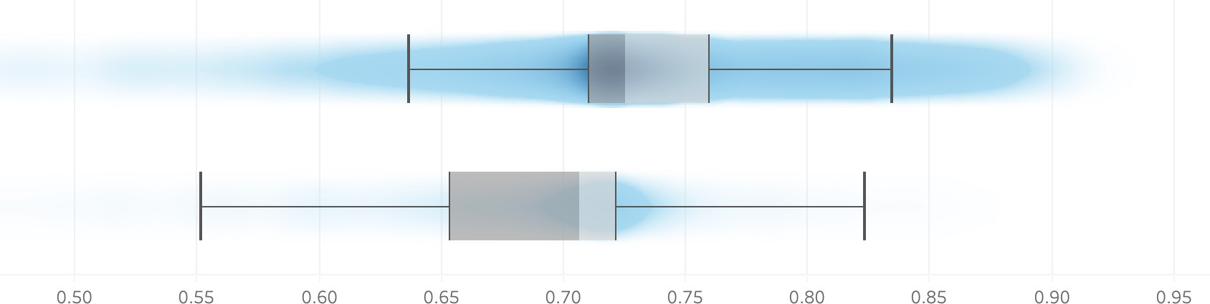
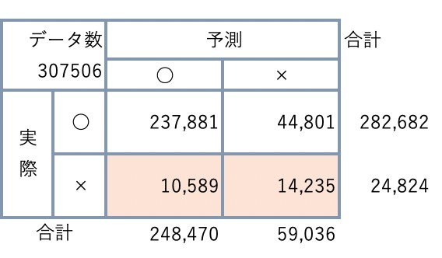
Validity of the Credit Score
Using the credit score, it is possible to distinguish non-defaulters and defaulters. Difference in credit scores by non-default vs. default.
Non-Defaulters Defaulters
From the graph on the left, the credit score tends to be: Non-defaulters: Often 0.71 or higher Defaulters: Often below 0.71
If we define credit score ≥ 0.7→☑︎︓ Non-defaulters < 0.7→×︓ Defaulter, then
Among defaulters,
Prediction
57%
Number of Data
Prediction
Total
can be detected
On the other hand, 44,801 cases (14% of all data) were mistakenly predicted x;
Therefore, classification by experts with specialized knowledge is necessary.
Results
Total

Slide 12
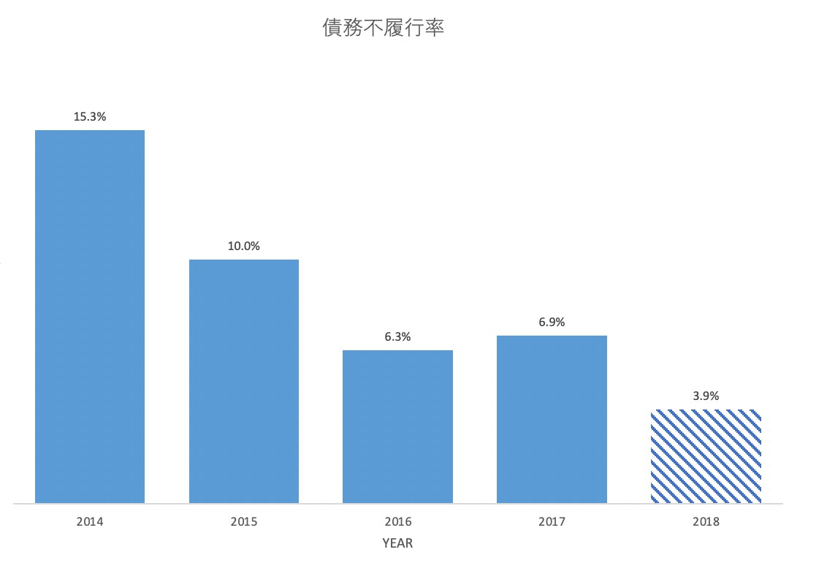
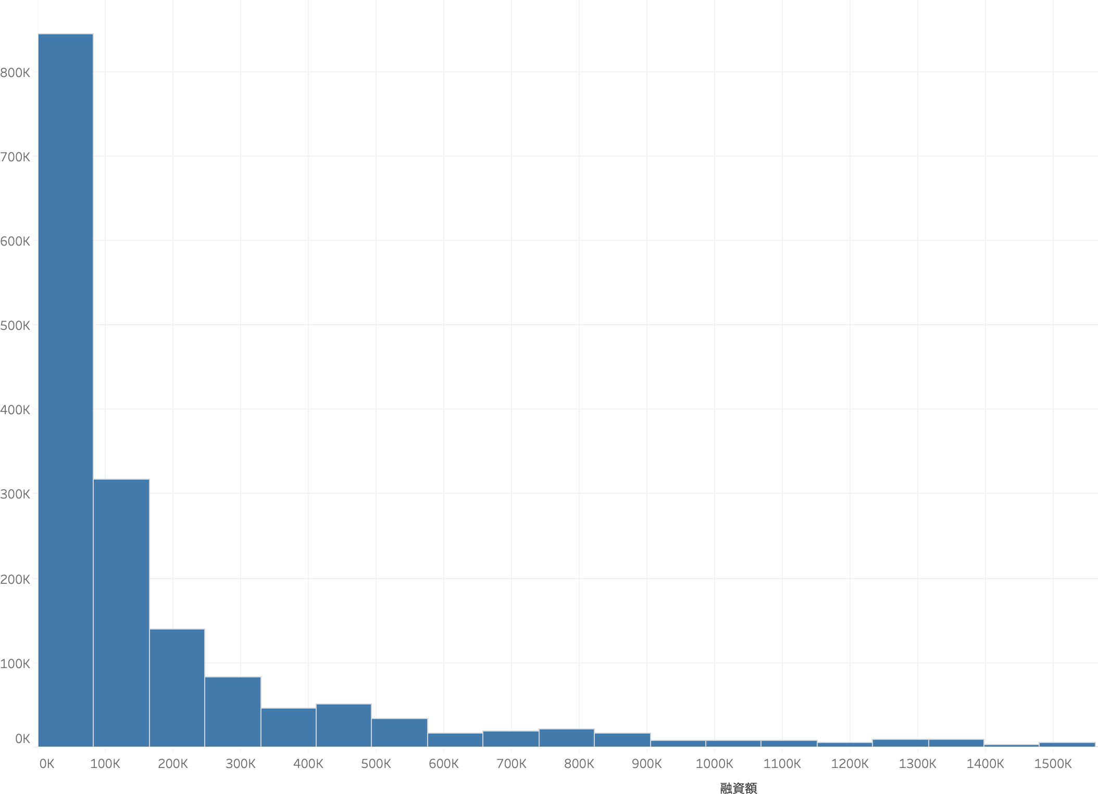
Impact on Revenue
Reducing the customer’s default rate leads to improved profitability.
3%
Assuming:
Median loan amount : 204,515 yen*
Annual number of loans: 41,608,720 people**
Source :Home Credit annual report 2017
Difference in default rate: 3%,
Apx. 255.2 billion yen
annually,
can be reduced
* As shown in the graph on the left, the distribution of loan amounts is right-skewed and the mean becomes large, so we estimate using the median (calculated with 1 tenge = 0.25 yen).
** Annual number of loans in 2017 listed on company’s website was used

Slide 13
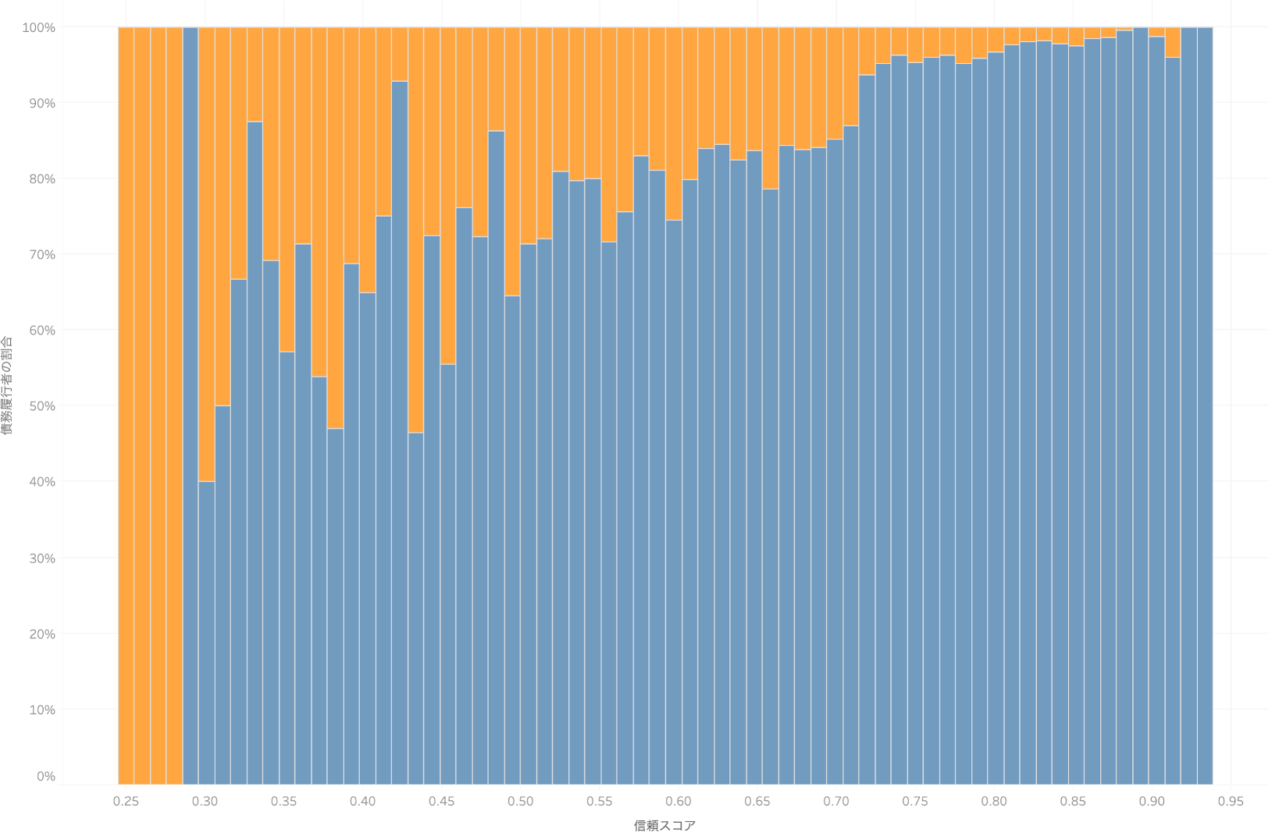
②Estimation of Low-Risk Customers by AI
It becomes possible to propose loan increases to customers whose probability of default is extremely low.
Proportion of defaulters Proportion of non-defaulters
Proportion of non-defaulters
←Low-risk customers
Credit Score
99.4%
of customers judged by AI to be low-risk*1 are non-defaulters.
Of the annual number of loans, 41,608,720 people*2, if we estimate low-risk customers at 5.5% of the total*3, then proactive approaches become possible to
Apx. 2.28million people
*1 Defined as customers with a credit score of 0.9 or higher
*2 Annual number of loans in 2017 listed on company’s website was used
*3 Calculated from the data you provided (17,035/307,506 = 0.055)

Slide 14
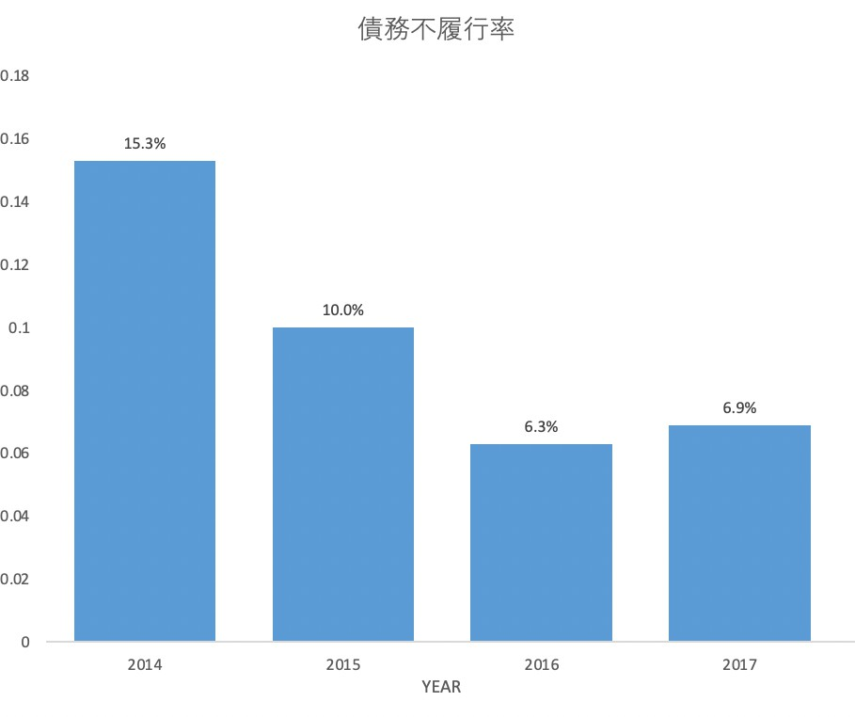
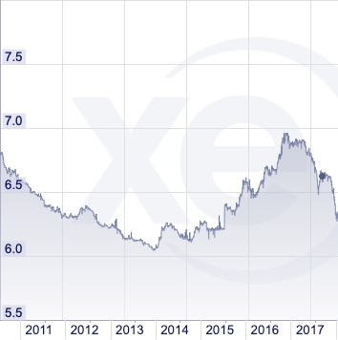
Long-Term Support
Through long-term consulting, lending that adapts to each country’s financial markets and economic trends becomes possible.
Source: Partially excerpted from BTMU (China) Weekly Economic Report 2017 The 0.6% increase in the default rate in 2017 is attributed to the rapid growth of the consumer finance market due to yuan depreciation in China, while the credit system for China was insufficient.
→To account for each country’s economic trends, utilize foreign exchange data.
Existing Data
＋ Foreign Exchange Data
Input
Machine Learning
Lending adapted to financial markets and economic trends becomes possible.
In addition, model updates can be implemented to improve the accuracy of lending decisions.

Slide 15
Quotation
In addition to the AI credit score, we propose long-term support.
AI Credit Score
Long-Term Support
Content
Risk Management
Reduce the default rate by 57% and prevent an estimated 25.52 billion yen in annual losses.
Estimation of Low-Risk Customers Enable approaches to 2.28 million reliable customers with a non-default rate of 99.4%.
We propose a fee of 30 million yen for providing AI.
This price corresponds to about 0.01% of the annual revenue improvement of 255.2 billion yen from risk management, plus the revenue from estimating low-risk customers.
Content
Time Series Analysis Lending decisions can be made in line with economic trends.
Model Updates Introduce economic indicators and text mining to improve accuracy.
Price
Price
We propose a consulting fee of 2.5 million yen per month.
To accelerate your business, our staff specializing in Finance × AI will utilize customer data to support you.
15

